Slide 1



1 R01 HL158825-01
Volunteers to Investigate Best Results for Ablation and Novel Therapies for Atrial Fibrillation
Funded by NHLBI/ NIH R01 HL158825-01
PI: Gregory M Marcus, MD, MAS
3/14/2023
Notes:
Thank you. It is my pleasure to present what we refer to as the HOLIDAY monitors study

Slide 2

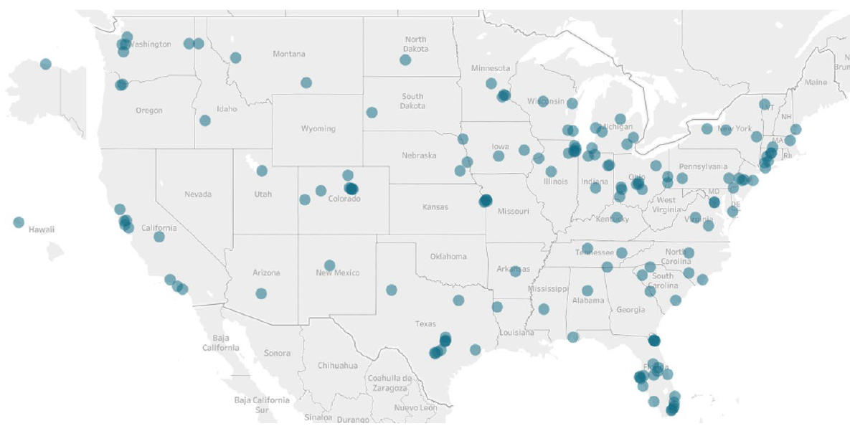
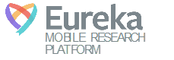
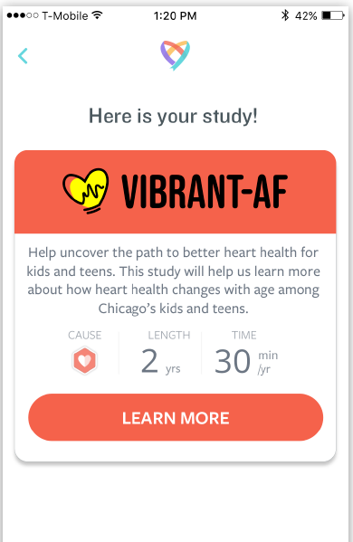
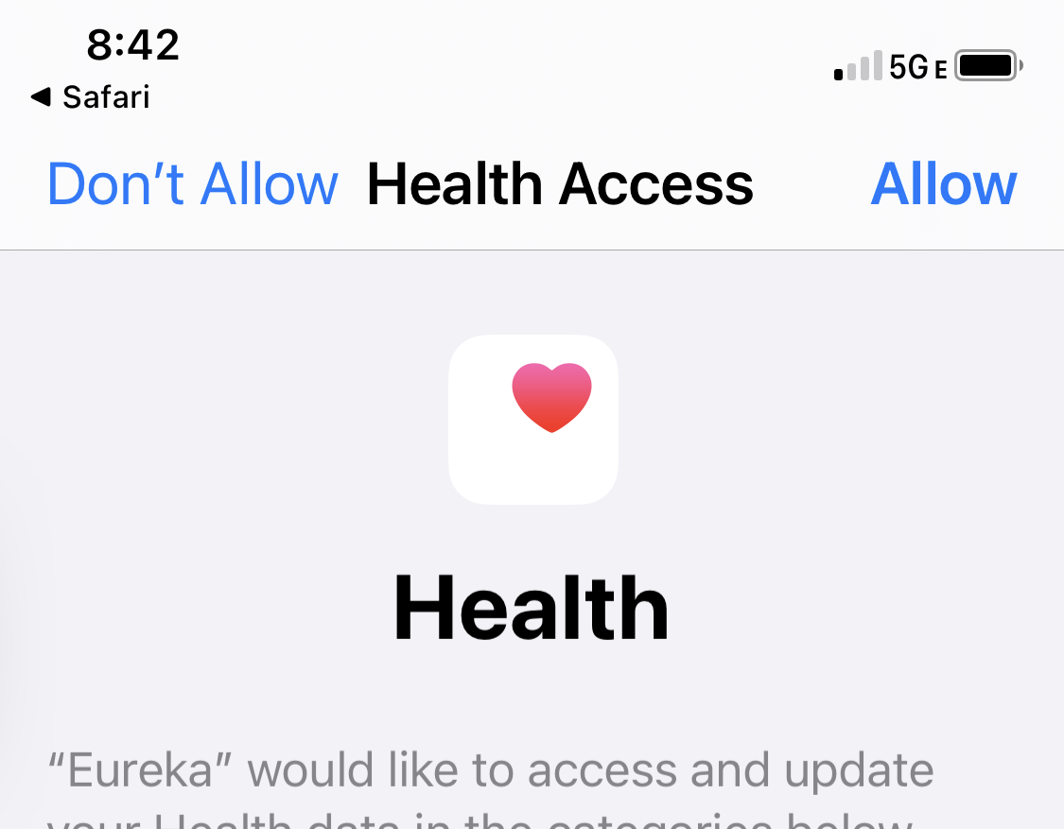
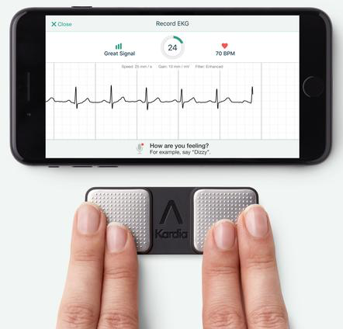
Longitudinal Follow-up
Complications
Effectiveness
Ongoing behaviors, treatments, exposures
2
VIBRANT-AF= Volunteers to Investigate Best Results for Ablation and Novel Therapies for Atrial Fibrillation
1 R01 HL158825-01

Slide 3
What is VIBRANT-AF?
A mobile app-based study
Enrolling any AF ablation patient with a smartphone
Organized to link with existing datasets
Collects:
Baseline and serial patient reported history, behaviors, and outcomes
HealthKit data
AliveCor KardiaMobile data
Passive ascertainment of hospitalizations using geofencing
EHR data
Other device data: Fitbits, BP cuffs, scales, glucometers, etc.
Notes:
Here are my disclosures

Slide 4

What is VIBRANT-AF?
Built using the Eureka Digital Research Platform
Notes:
Here are my disclosures

Slide 5
Participant enrollment
Notes:
Here are my disclosures

Slide 6
Participant enrollment
Specific to site
Allows tracking of each use by site
Facilitates data linkage, numbers by site, data sharing by site
Unique participant code can be used to link with site-specific or registry data sets
Notes:
Here are my disclosures

Slide 7
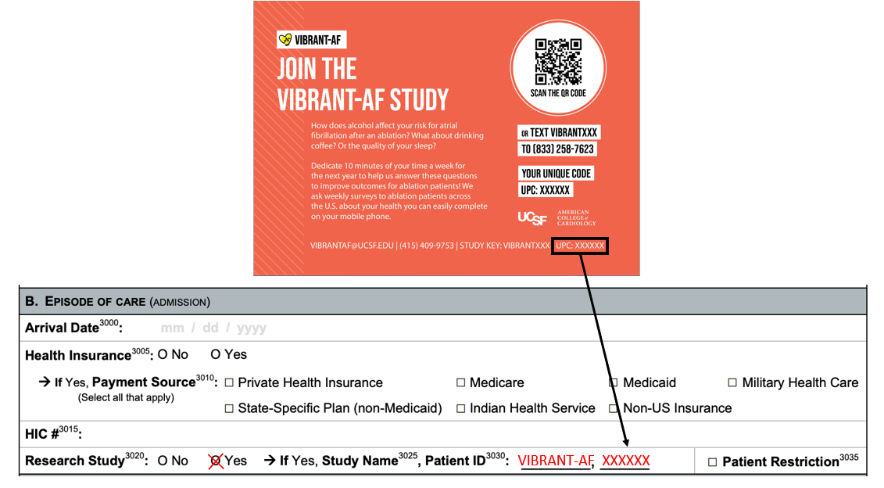

Slide 8

Name | Date of Procedure | UPC
John Smith | 2/13/2023 | ABCDEF
Jane Doe | 2/15/2023 | GHIJKL
John Doe | 2/19/2023 | MNOPQR
Jane Smith | 2/21/2023 | STUVWX

Slide 9
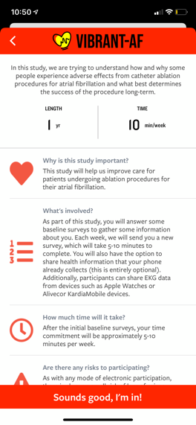
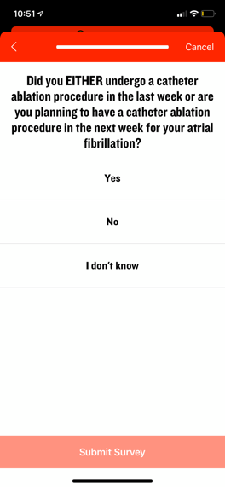
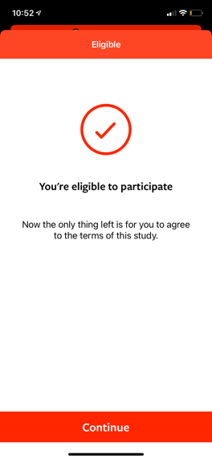
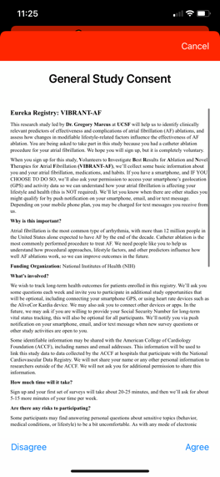
Participant Onboarding
Consent is obtained via the app (UCSF IRB approved)

Slide 10
IRB approval?
NCDR AF ablation sites should not need any additional IRB approvals/ paperwork/ agreements/ contracts
VIBRANT-AF uses UCSF IRB-approved consent via the app
Patient could very well consent at home or in the grocery store
The NCDR quality-initiative IRB (with waiver of consent) has been modified to incorporate VIBRANT-AF, including allowing for sites to inform patients being enrolled in the registry that VIBRANT-AF is available to them.

Slide 11
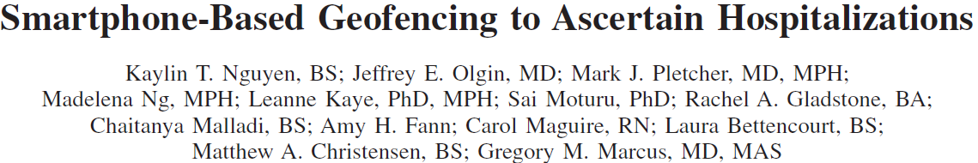
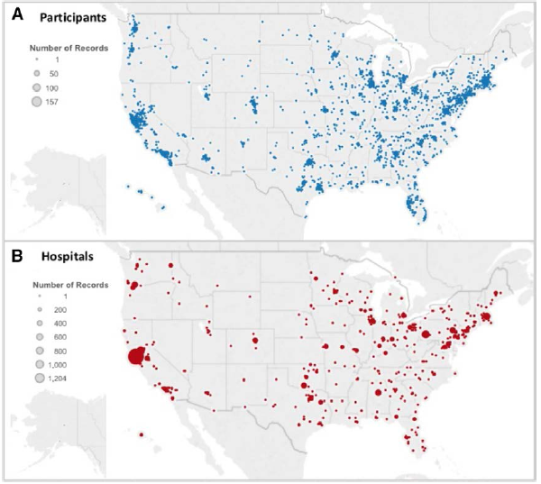
In-person pilot (n=22): 77% sensitivity (95%CI 55-92)
Remote:
3,443 participants in all 50 US states
243 hospitalizations detected over ~1 year
PPV 65% (95% CI 65-72%)

Slide 12
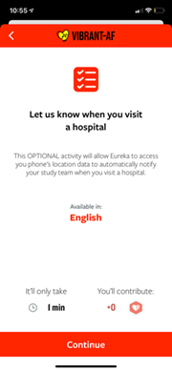
Participant Onboarding
Geofencing for Hospitalizations
Triggered when present > 14 hours
Results in a hospitalization-specific survey

Slide 13
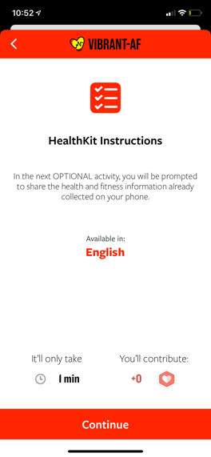
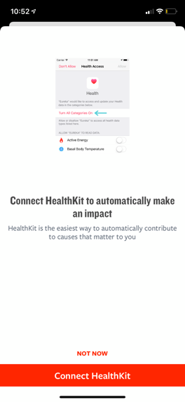
Participant Onboarding
HealthKit
Includes step counts
Includes AppleWatch data
The challenge: Data processing

Slide 14
Baseline Surveys
BASELINE AF-EQT (currently requires in-person interview)
Basic Demographics
Education and Income
Characterizing AF (initial diagnosis, type, burden, past treatments)
Other Medical Conditions
Family History
Caffeine Consumption
Emergency Contact

Slide 15
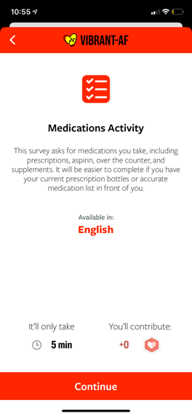
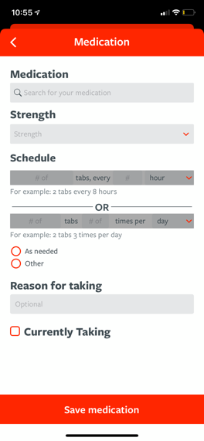
Medications

Slide 16
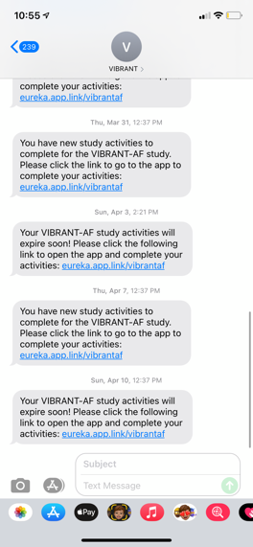
Messaging Weekly + Reminders
Participants receive a push notification, followed by a text one hour later if the “eVisit” is not completed
If the eVisit remains incomplete, they receive a reminder 3 days later
The timing of the notifications = the time of day they consented
Several important activities remain in the eVisit until complete

Slide 17
Other Baseline Surveys Sprinkled In
Alcohol Use (week 1)
Smoking History (week 2)
OPTIONAL: SSN Collection Survey (week 3)- for connection to National Death Index

Slide 18
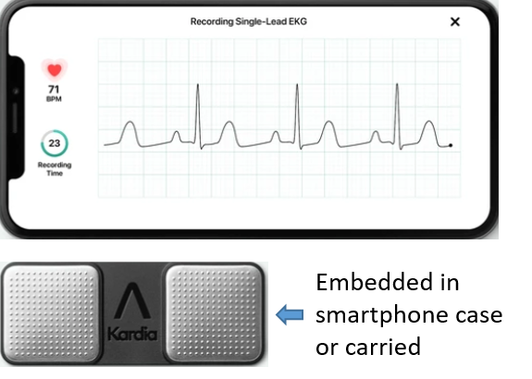
Other Baseline Activities in the First Month
AliveCor KardiaMobile Connections
We provide a unique code that enables collection of all AliveCor reads and ECG strips

Slide 19
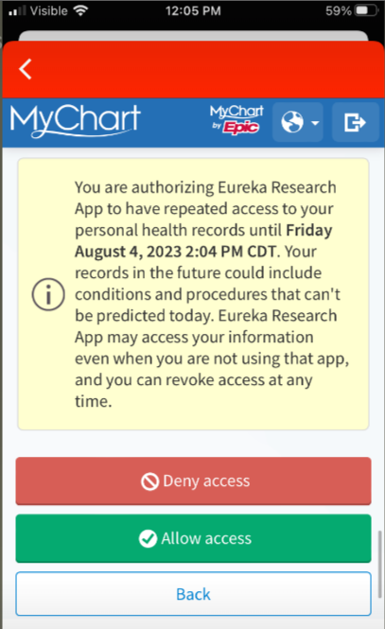
Other Baseline Activities in the First Month
EHR connections for any Epic installation (estimated to be ~50% of all medical institutions in the US)

Slide 20
Weekly Surveys
Note: only in regards to the past week, helping to mitigate against recall bias and to assess patterns over time
Complications (x first 6 weeks)
Interim atrial fibrillation or flutter
Affirmative answers trigger subsequent questions regarding symptoms, duration, frequency, ECG documentation
Medications (autofill from previous entry→ edit as needed)
Habits
Alcohol, caffeine, exercise, sleep

Slide 21
Monthly Surveys
Validated physical activity survey (IPAQ)
Shortness of breath/ exercise tolerance survey
ED visits
Hospitalizations

Slide 22
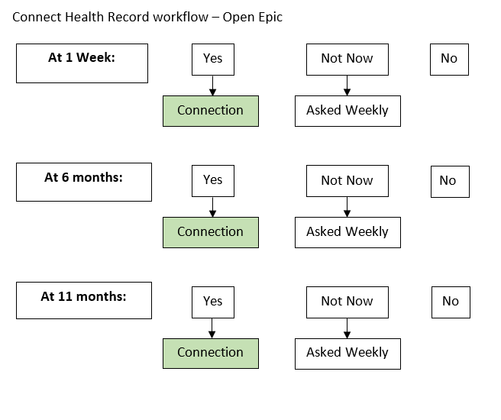
Every 6 months
AFEQT (validated AF-related quality of life)
Opportunity to connect medical records again and/ or add a new provider

Slide 23
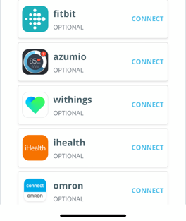
Other Optional Connections Given Explicit Direction (such as via a research coordinator)
Various Bluetooth-enabled devices via APIs (once a connection is forged, the study collects all connected data)
Fitbits
Scales
BP cuffs
Glucometers
Fitness mobile apps

Slide 24
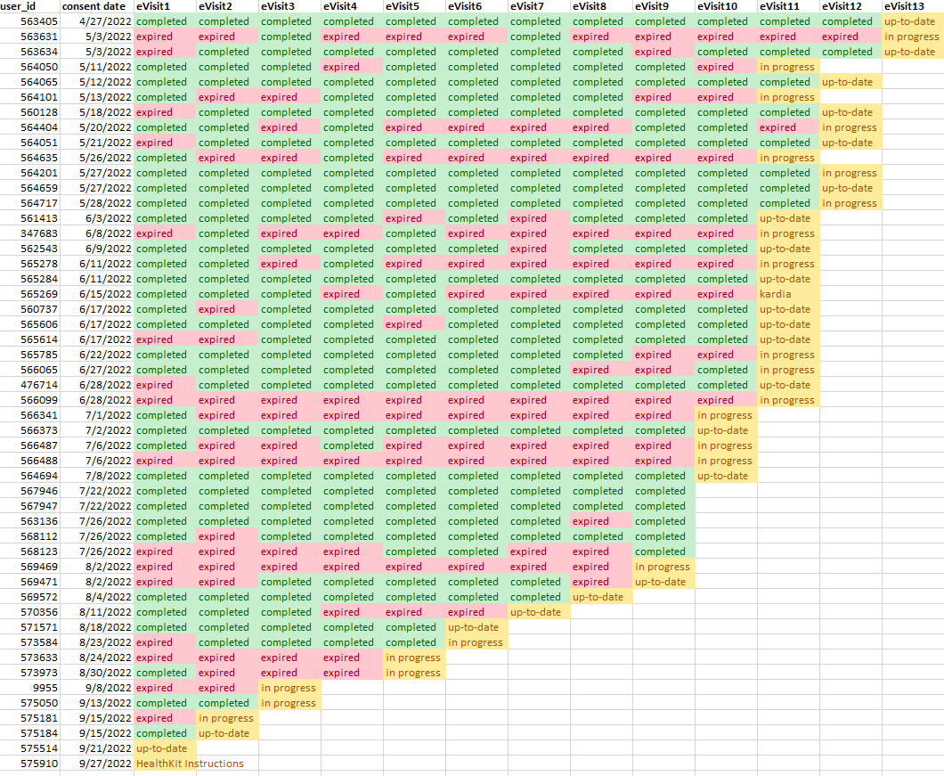

Slide 25
Translation
A Spanish version is now available
Other languages are also possible!

Slide 26
How do we get started?
We (UCSF team) needs contact name and address
We then (make with custom QR codes, text-backs and UPCs) and send the business cards

Slide 27
Funded by the NHLBI
Intended to be of use to sites
Funding relies on meeting enrollment milestones
Which relies on sites

Slide 28
Thank You
greg.marcus@ucsf.edu
vibrantaf@ucsf.edu
‪ (415) 409-9753

